Slide 1


ASCENT & TREP
Junior Presentation
Programs designed and funded by the State of Colorado to help students move into post-secondary education with financial support

Slide 2
All Candidates
ASCENT
TREP
  Must apply for FAFSA and/or CAFSA
  CANNOT accept federal aid during ASCENT/TREP
  Must be college ready (details on slide 5)
  CCSD pays for tuition, books, and fees* associated with the courses
  Students are considered a 5th year senior & High School Diplomas are given after the ASCENT/TREP year(s)
  Students attend CCSD partner college/university
Accelerating Students through Concurrent ENrollmenT
  One year program (options for full-time or part time)*
  Students must have a minimum of 9 college credits, successfully completed (C or better), transcribed on a college transcript.
  Slot limitations based on 24/25 enrollment
Teacher Recruitment Education & Preparation
  Two year program for students looking at education pathways
  Specific number of slots issued by State of Colorado. Decisions of who will be sponsored with TREP are made in May.
  Students must take one of the required courses DURING their senior year (details on next slide). FEP students automatically meet this coursework requirement.
Notes:
- Socially graduate with their class
- Full time and part time available

Slide 3








ASCENT TREP Partners

Slide 4
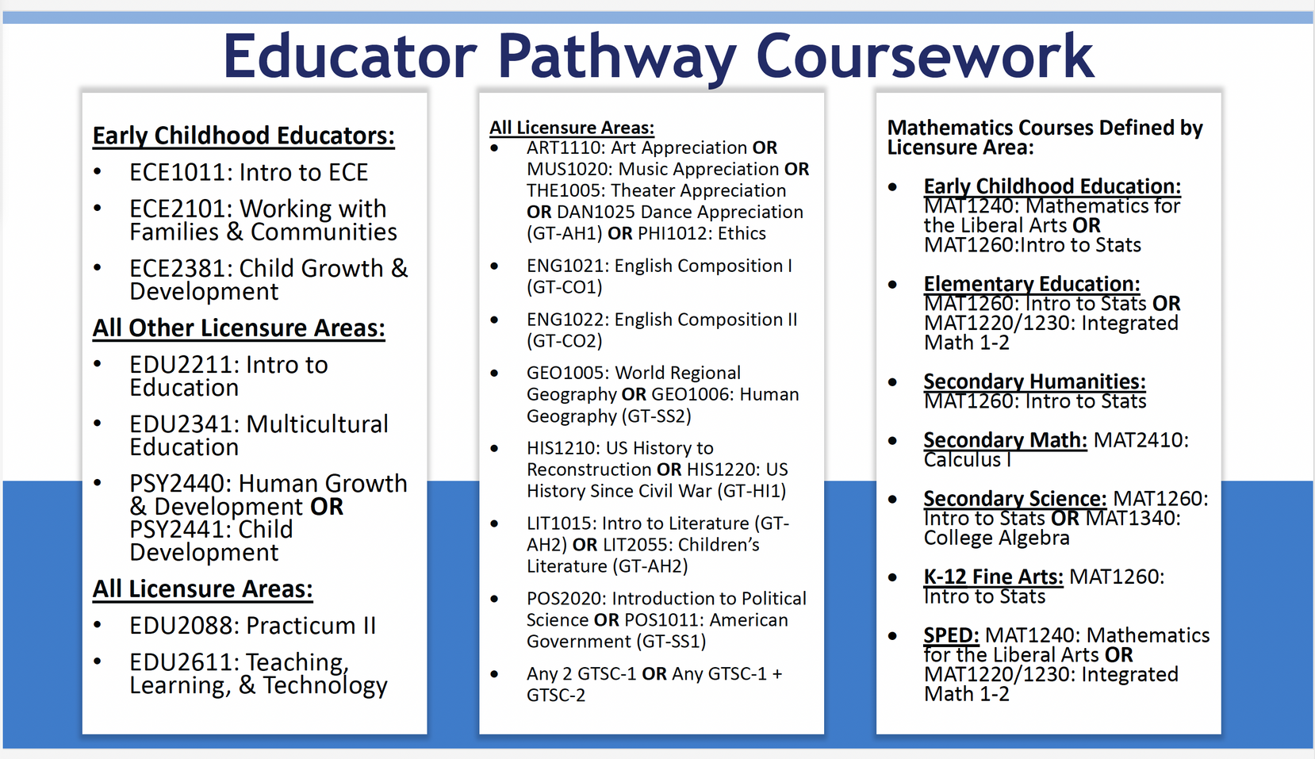
TREP
Students must take one of these required courses DURING their senior year to be eligible for TREP.
These are the course names and numbers specified by the Colorado Department of Education and may be referred to differently at your home high school. Ask your counselor.

Slide 5

What is College Readiness?
ENGLISH MATH
Pick one:
  SAT English - 470
  ACT English - 18
  ENG 1021 - English Composition, C or better, registered for college credit
  Accuplacer Next Generation Writing - 246
Pick one:
  SAT Math - 500
  ACT Math - 19
  MATH 1340 - CE College Algebra, C or better, registered for college credit
  Accuplacer Next Generation AAF - 235

Slide 6

State requires you to apply for FAFSA or CAFSA to be eligible for ASCENT/TREP
ASCENT/TREP
FAFSA/CASFA
Tuition
Books
Loner Laptop
Required Fees Billed by College/Program (not housing/meals, not private flight lessons, not transportation)
One
or the Other
NOT BOTH!!
Pell Grants
Guaranteed Student Loans
Colorado Student Grants
Institutional Aid such as Merit Scholarships
*Work Study
Other State Aid
*can work an hourly on-campus position

Slide 7

Juniors - Time to Plan
  Meet with your home high school counselor.
  ASCENT - Assess your progress toward 9 college credits.
  TREP - Plan for required course senior year. Look into the Future Educator Apprenticeship to start earning and learning about teaching careers.
  Select courses for senior year.
  Be aware the State Legislature can update/modify ASCENT TREP programs each year.

Slide 8
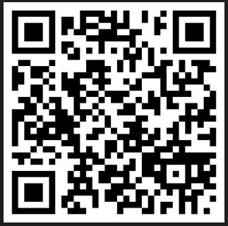

www.cherrycreekschools.org/Page/14839
Seniors - How to Apply
  Meet with your home high school counselor to see if you qualify or can qualify by Spring 2025
  Apply to your desired college/program and pick a major/concentration.
  Complete a FASFA or CAFSA application.
  If you will be using AP test scores from junior year for college credit, go to college board and send AP scores to the college/university you want to attend in order to be transcribed (for ASCENT.)
  Access your unofficial COLLEGE transcripts and download into a pdf
  Apply! The application will open February 1st and will close the end of March.
FEB 1- MARCH 31

Slide 9

Frequently Asked Questions
  Why does the district hold my diploma until I finish the ASCENT or TREP programs?
    Both programs are concurrent enrollment. In order for students to participate in these programs, they must remain high school students in order to qualify for concurrent enrollment.
  Can I graduate early and participate in ASCENT or TREP?
    Unfortunately, legislation is clear in that a student can only participate in these programs following their 4th year of high school directly following their 12th grade year. This language also takes out the option of students taking a gap year before going to college.
  Can I participate in ASCENT to earn a certification?
    Absolutely! Attending one of the community colleges or a technical college is a great place to earn a certification.
  What if I fail a class?
    If you fail a class, that class grade will be on your high school and college transcripts. It is essential to work with your college advisor on appropriate courses. The district will not ask you pay for the failed course.

Slide 10

Frequently Asked Questions
  Can ASCENT/TREP students live on campus?
    You will need to check with the institution to see what their requirements are for living on campus.We do not pay for housing or meal plans (UNC).
  Can I use financial aid with the ASCENT/TREP program?
    No. Because students are retained as a CCSD high school student, you are not able to accept financial aid.
    Students can apply for scholarships that do not require first-time, undergraduate college student status.
  What will it look like when I matriculate to a four-year university?
    That will depend on the university. It is highly suggested that you meet with a college advisor from the university that you’d like to attend after your ASCENT/TREP year(s).
    They can help make the decision which course you should take and determine how the courses will transfer.
  Can I use AP/IB/CLEP test scores to qualify for ASCENT?
    Yes, but the test score needs to be transcribed to count as a part of the 9 credits required for eligibility.

Slide 11
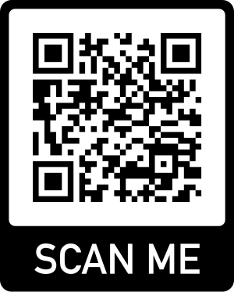
Contacts and Resources
Your high school counselor
PostSecondary Workforce Readiness Department
Brittny Blechar, Partner of ASCENT and TREP, bblechar@cherrycreekschools.org
Tara Bell, Administrator, tbell18@cherrycreekschools.org
Margaret Krob, Dept. Specialist, mkrob@cherrycreekschools.org
Your high school course guide lists CE classes
District website < Programs < Career and Technical Education
Colorado Department of Education Website
https://www.cde.state.co.us/postsecondary/ascentfaqs
https://www.cde.state.co.us/postsecondary/trepfaqs
www.cherrycreekschools.org/Page/14839

